Slide 1

TensorFlow Object Detection

Slide 2
Introduction:
TensorFlow object detection model is an open source framework which is built on top of TensorFlow that makes it easy to construct, train and deploy object detection models. The purpose of this project is to create precise machine learning models which has the ability of localizing and identifying multiple objects in a single image.
Objectives:
Identifying and detection multiple objects in a single image and differentiating between them.
Giving the accuracy of the objects in a webcam or video or an image.
Generating Video stream using the webcam.

Slide 3
Requirements and Installation:
First, we need to install the TensorFlow using PIP command.
We need to download TensorFlow Object Detection API and Protocols from TensorFlow GitHub.
The Version of the Protocol Should be 3.4 i.e. Protoc34.
Import the cv2 file for the video capturing and object detection of the video.
Configuration:
Python 3.6.4
Protoc 34
TensorFlow library

Slide 4
TensorFlow Overview:
This application has the following components:
TensorFlow: It runs on multiple computers to allocate the training workloads.
Object Detection: Used to construct, train and deploy object detection models.
Pre-trained object detection models: The object detection API gives the pre-trained object detection models. In this case, users are not required to train models from scratch.

Slide 5
TensorFlow:
TensorFlow is an open source software library for high performance numerical computation. Its flexible architecture allows easy deployment of computation across a variety of platforms (CPUs, GPUs, TPUs), and from desktops to clusters of servers to mobile and edge devices.
NumPy:
NumPy is the fundamental package for scientific computing with Python. It contains among other things:
a powerful N-dimensional array object
sophisticated (broadcasting) functions
tools for integrating C/C++ and Fortran code
useful linear algebra, Fourier transform, and random number capabilities

Slide 6
CV2:
OpenCV-Python is a library of Python bindings designed to solve computer vision problems. ... All the OpenCV array structures are converted to and from Numpy arrays. This also makes it easier to integrate with other libraries that use Numpy such as SciPy and Matplotlib.

Slide 7
Input/output Screen shots:
Task: Imports
The Objects detection requires some of the libraries
1.Tensor Flow Library
pip install tensorflow
2. Dependencies
pip install --user Cython
pip install --user contextlib2
pip install --user pillow
pip install --user lxml
pip install --user jupyter
pip install --user matplotlib
3. Adding Libraries to pythonpath
export PYTHONPATH=$PYTHONPATH:`pwd`:`pwd`/slim

Slide 8
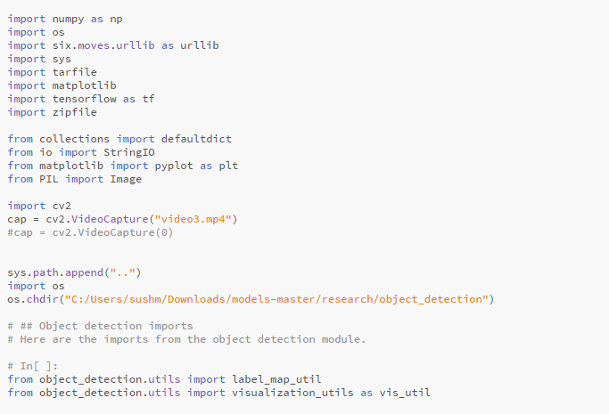
Implementation and Code Snippet:

Slide 9
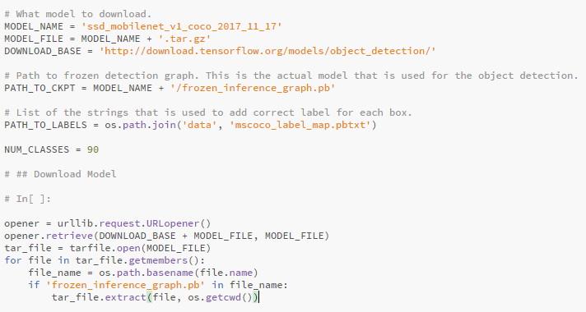
Task 2: Downloading the models

Slide 10
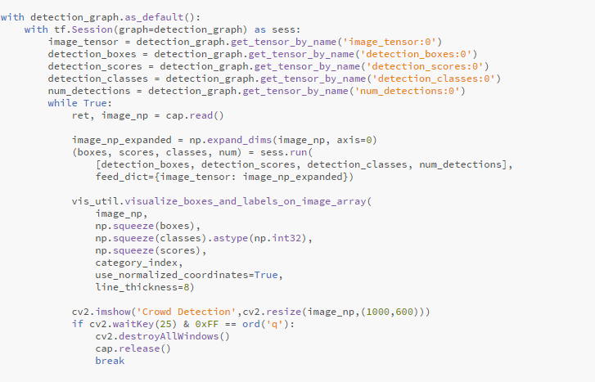
Task 3: Detection Graph

Slide 11
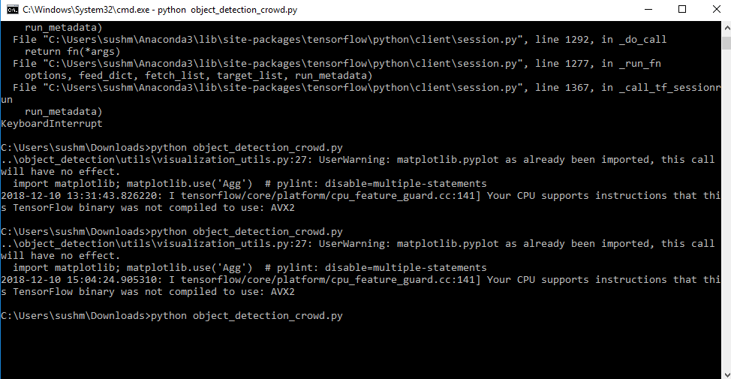
Deployment:
We are executing the python file with the command prompt as it needs to load the library and unzip the modules.

Slide 12
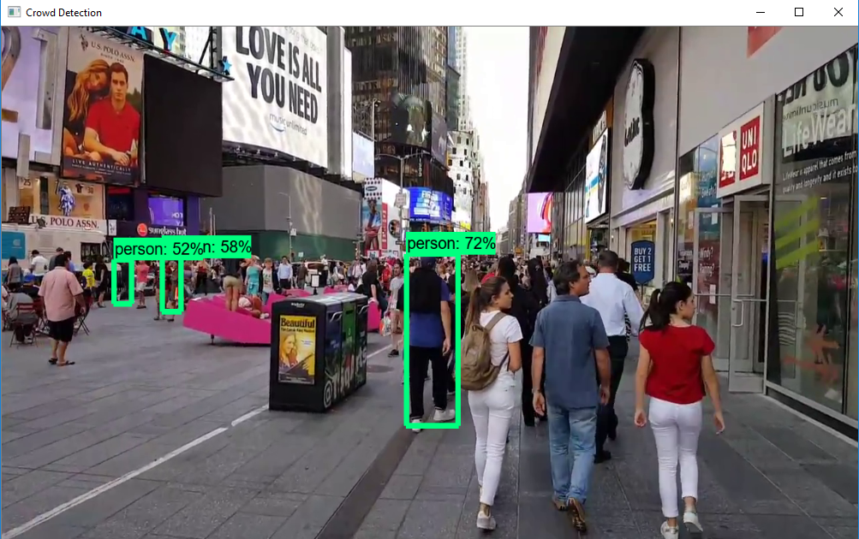
1.The output of the video.mp4

Slide 13
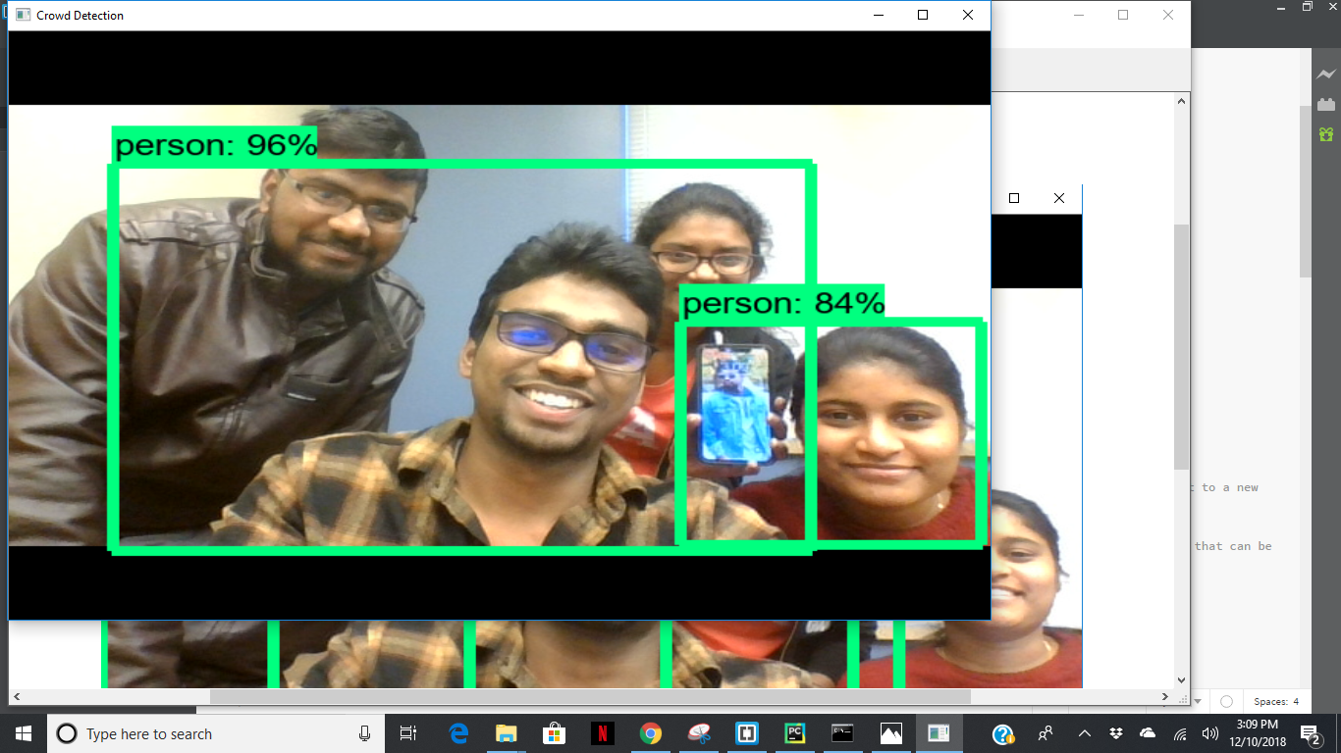
2.The output of the webcam

Slide 14
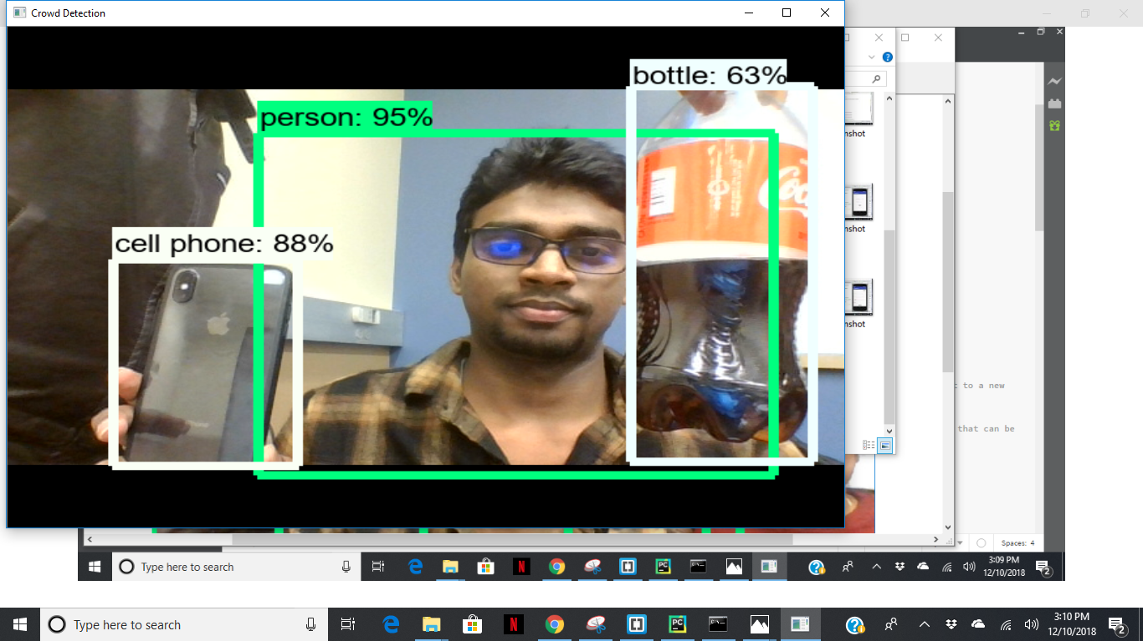

Slide 15
Limitations:
It does not detect all the objects in the screen, like the accuracy won’t be 100%.
The model should be trained, and the objects should be distinguished as it is an ongoing research the model will be improved with time.
It also has some difficulty distinguishes between the same objects.

Slide 16
References:
https://github.com/tensorflow/models/tree/master/research/object_detection
https://medium.com/@WuStangDan/step-by-step-tensorflow-object-detection-api-tutorial-part-1-selecting-a-model-a02b6aabe39e
https://pythonprogramming.net/introduction-use-tensorflow-object-detection-api-tutorial/

